Slide 1

BLOOD DONATION
SUBMITTED BY –
Priyanshu Panwar 12205439
Parveen jangra 12205773
mohit kumar sirwa 12206169
UNDER THE GUIDANCE OF
DR. Bhupinder singh

Slide 2
AIM AND OBJECTIVE OF PROJECT:
The objective of this website is to develop an online blood donation information for all the people.
To bridge the gap between blood banks, hospitals, volunteer donors and needy people, through this system.
To facilitate the search process for needy people and make it easier than before.
To reduce the data entry process.
It can be used to connect people who want to donate blood with our blood bank by registering through a simple process
The website aims to maintain the complete information about donors, receivers and blood donation camps Which can be resourceful to other institutions also.

Slide 3
INTRODUCTION:
The average adult has about five liters of blood living inside of their body, coursing through their vessels, delivering essential elements, and removing harmful wastes. Without blood, the human body would stop working. Blood is the fluid of life, transporting disease fighting substances to the tissue and waste to the kidneys.
Hence here we have made an interesting website by using HTML to help people take care of others by donating blood.

Slide 4
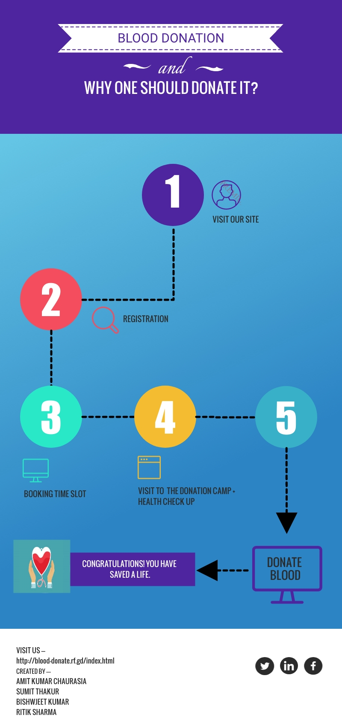
Steps to donating
Blood:

Slide 5
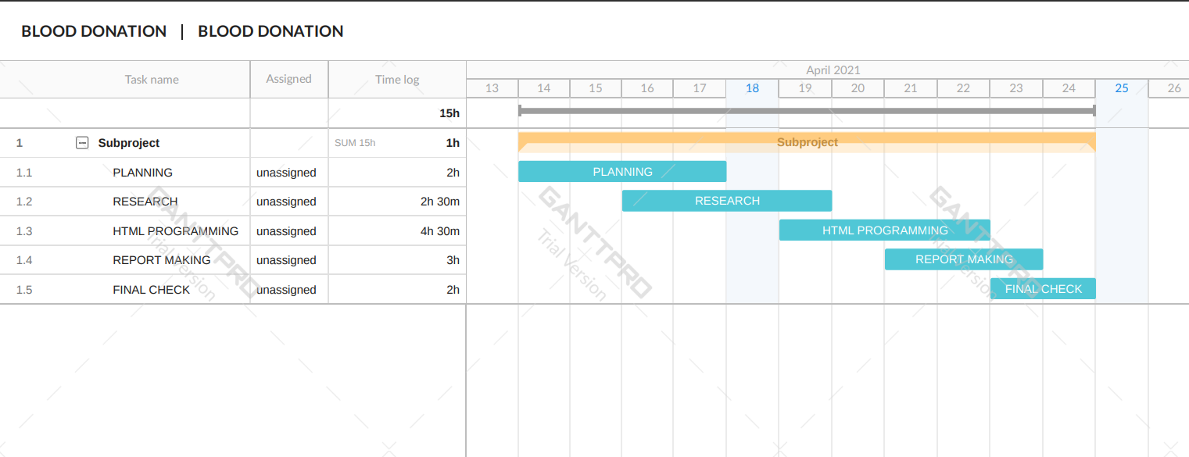
Gantt chart OF THE PROJECT:

Slide 6
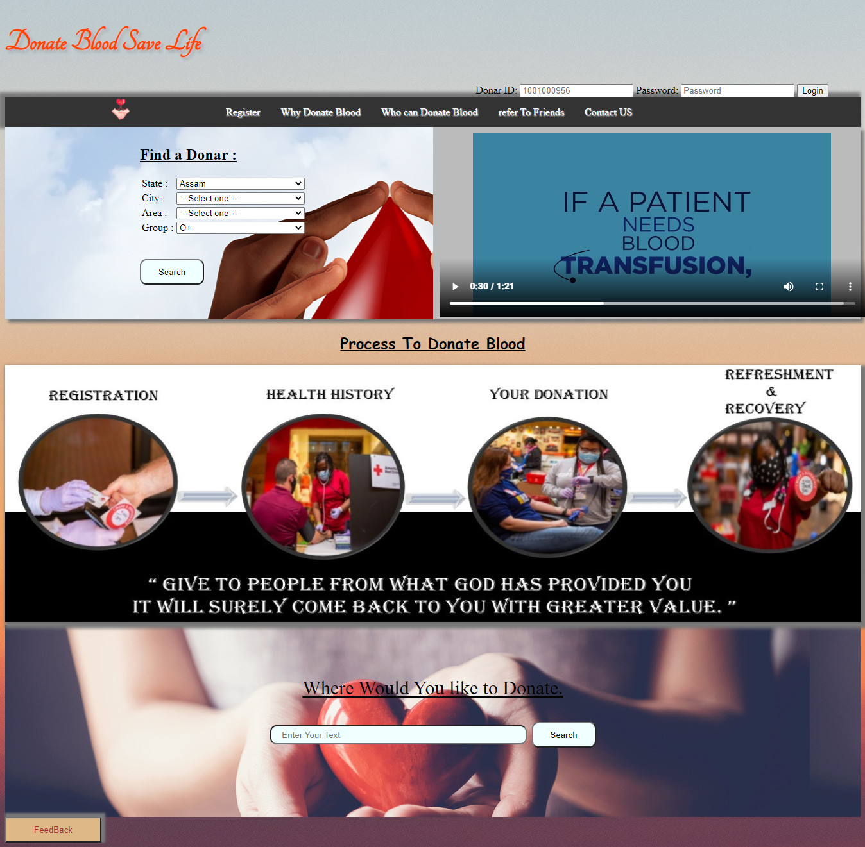
Glimpse of the website:
HOMEPAGE:

Slide 7
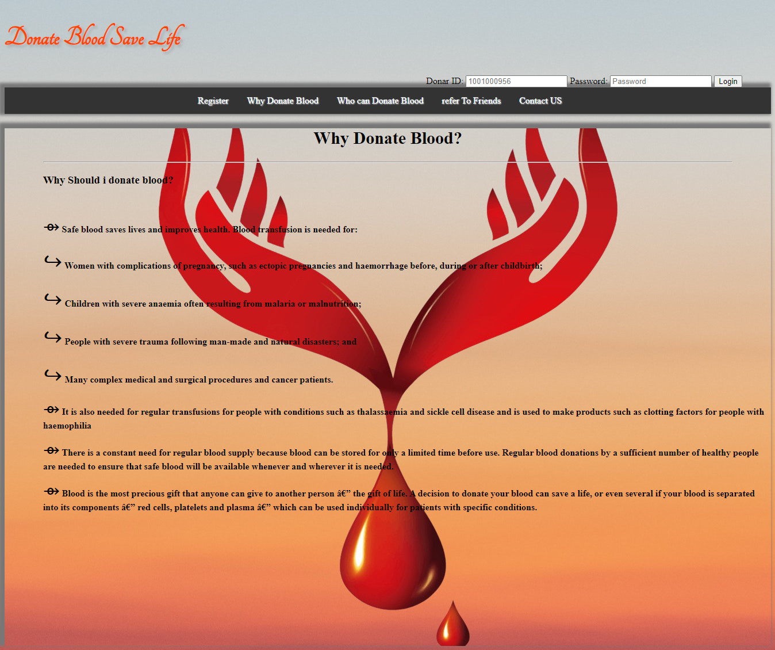
WHY DONATE BLOOD:

Slide 8
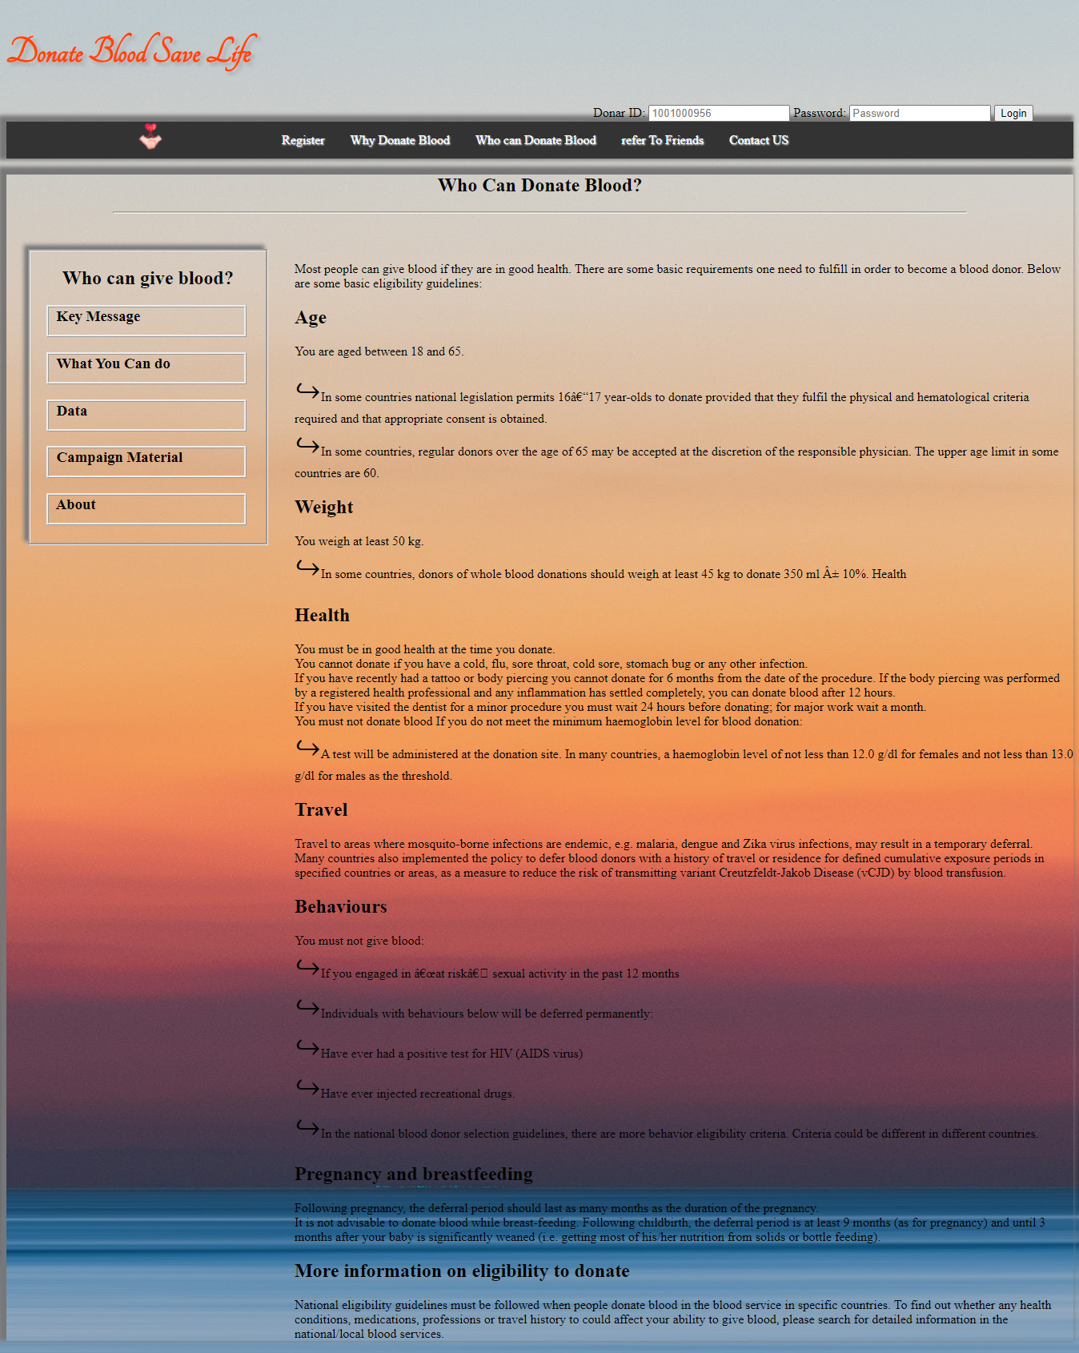
WHO CAN DONATE BLOOD:

Slide 9
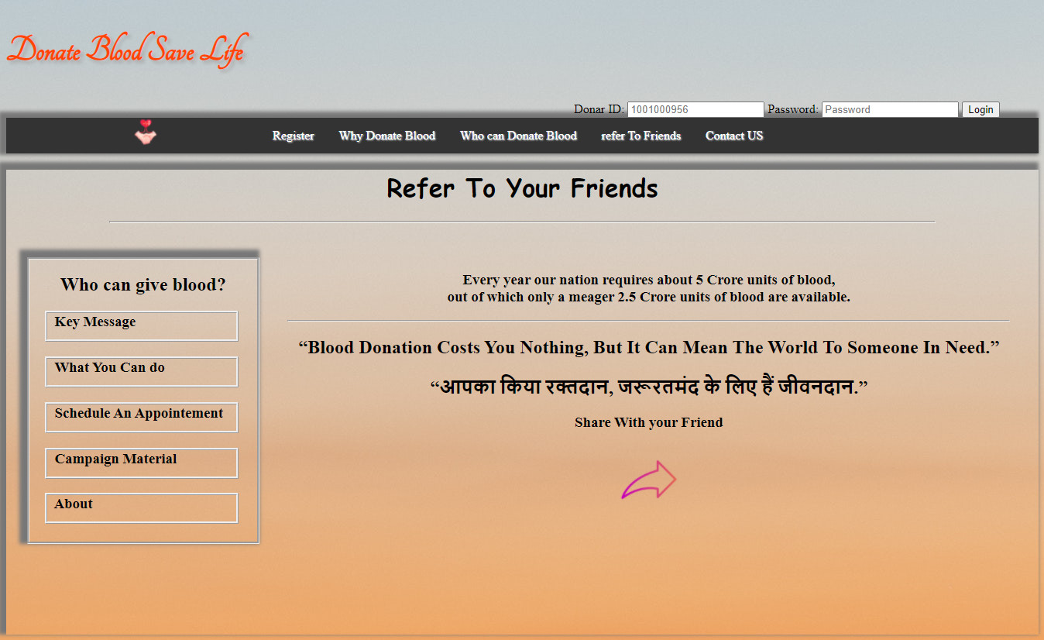
REFER TO YOUR FRIENDS:

Slide 10
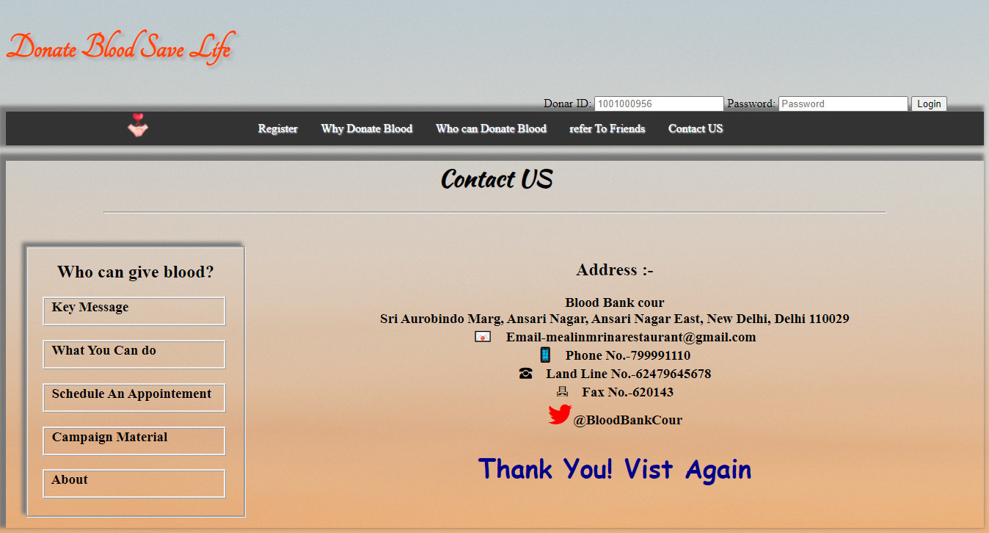
CONTACT US:

Slide 11
HTML Tags and Attributes Used in website :

Slide 12

NOW TO VISIT OUR SITE CLICK ON THE LINK GIVEN BELOW:
http://blood-donate.rf.gd/index.html

Slide 13

The End

